Slide 1
Resume tips

Slide 2
Show experience
Mistake 1

Slide 3
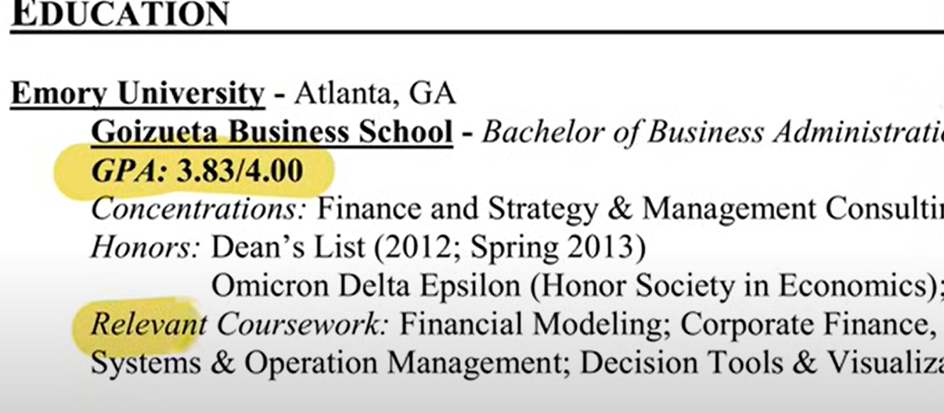
Mistake – GPA

Slide 4
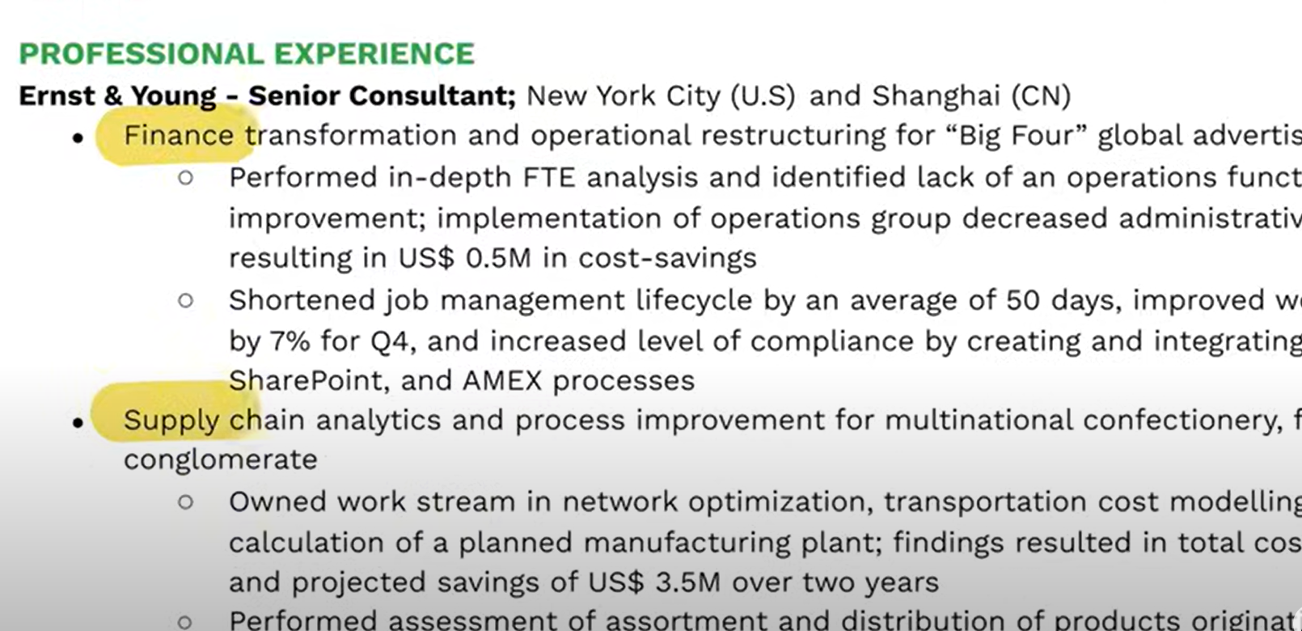
Solution – Show Experience

Slide 5
Common Words
Mistake 2

Slide 6
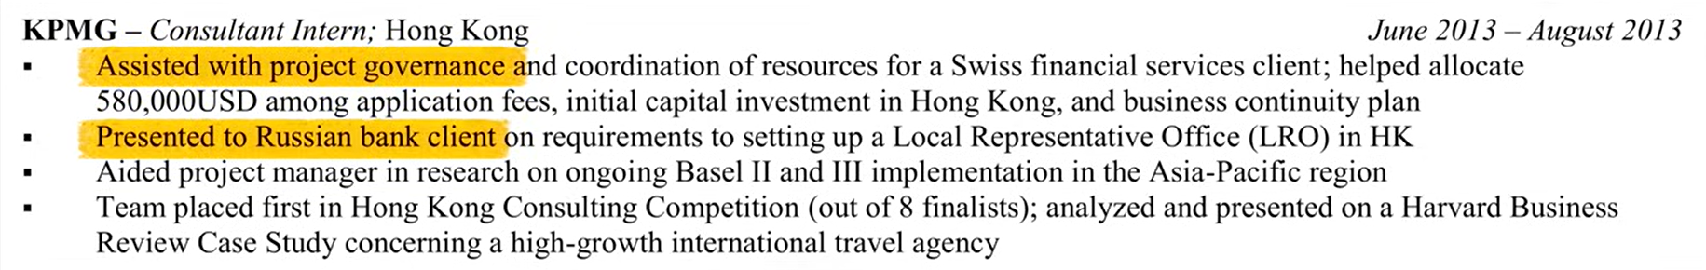
Mistake - Common Words

Slide 7
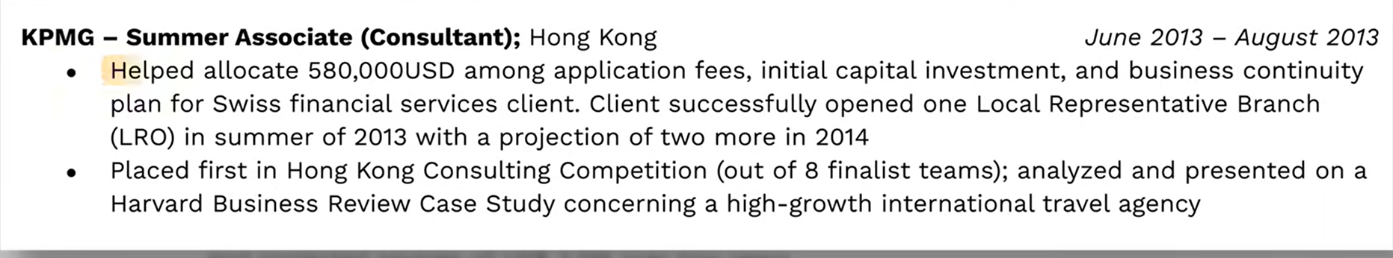
Solution – Show Impact

Slide 8
Common Metrix
Mistake 3

Slide 9

Mistake – General matrix

Slide 10
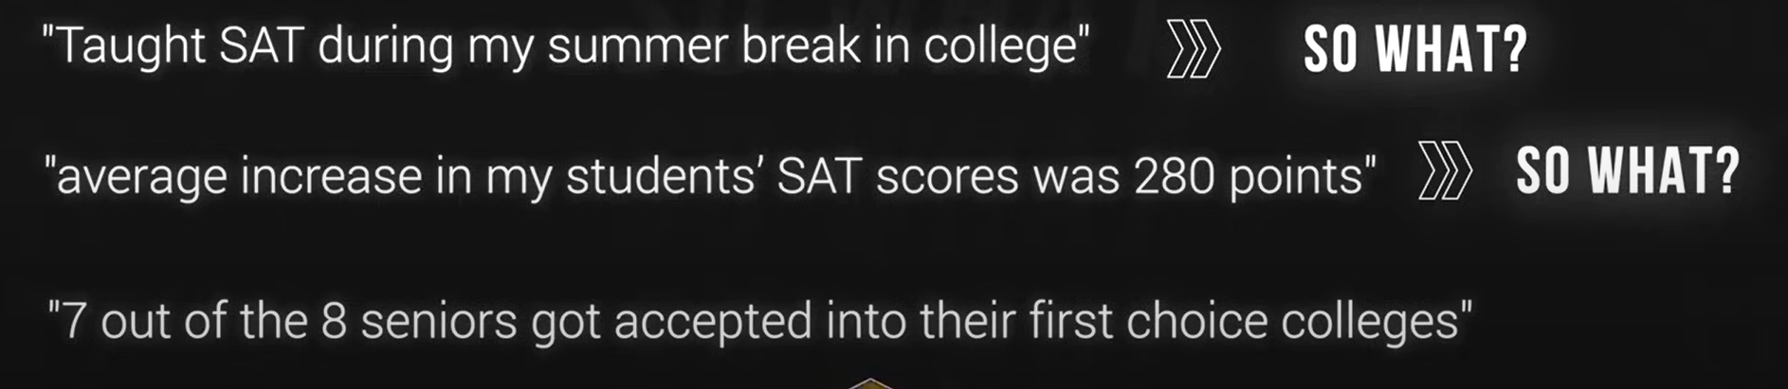
Solution – Show Achievement

Slide 11
Sending same resume
Mistake 4

Slide 12
Adjust resume to new position
Invest in the quality of the application
Select 2 -3 positions you want to apply
Create a separate version for each position
Use word cloud generator

Slide 13
Layout Format
Mistake 5

Slide 14
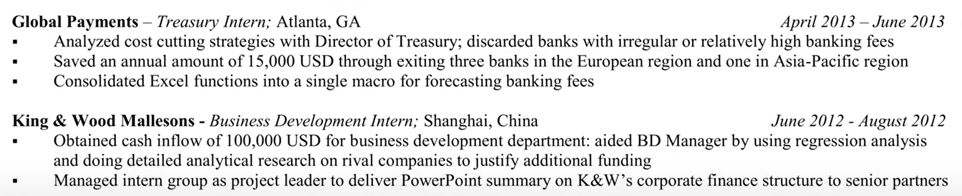
Layout / Format

Slide 15
Identify Key Words
Mistake 5

Slide 16
Successful Resume
Summary
3 -4 sentences summarizing your brand
Professional statement
Highlight your achievements skills
Years of experience
Accomplishments
Resume Layout
Clean / Appealing / Standardized / Appealing to the eyes/ Error Prove

Slide 17
Identify key words
Using Prompt Engineering
Example: can you identify 5 keywords and skills from this job description? Copy and Paste job description

Slide 18
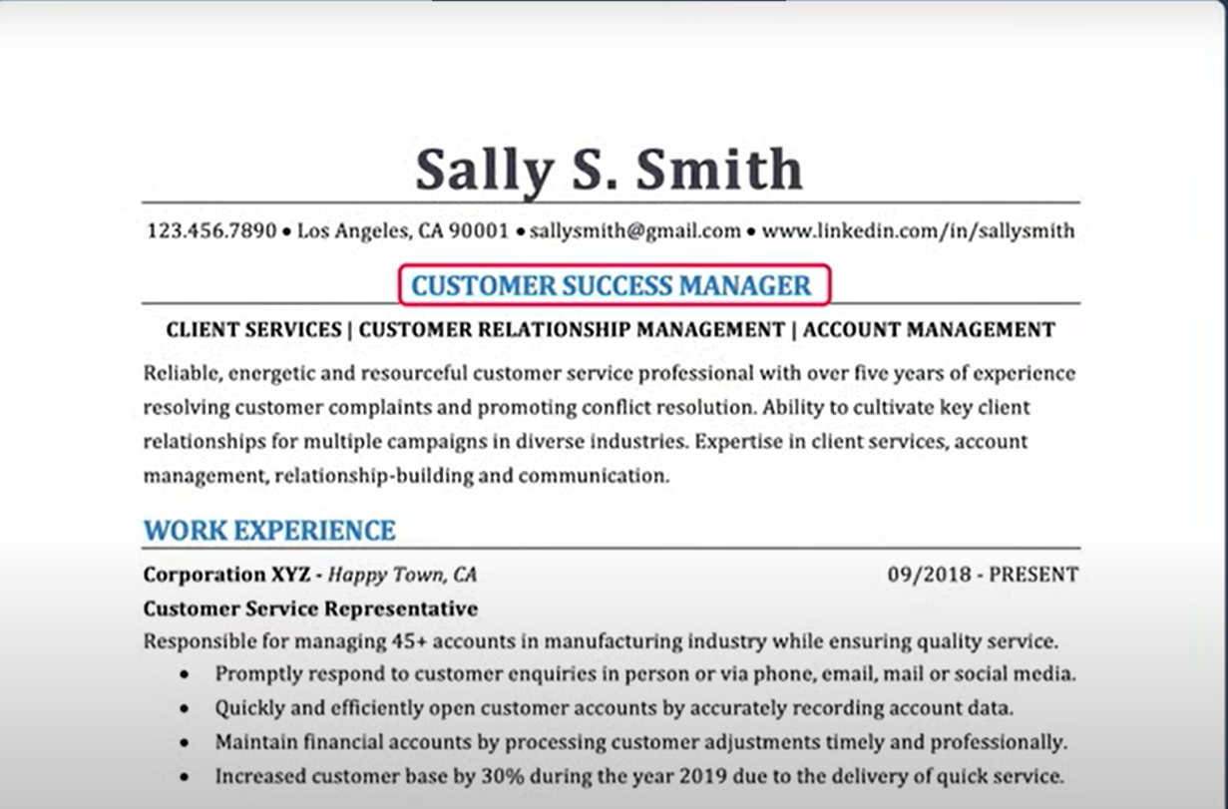
Example

Slide 19
Summary
Using Prompt Engineering
Example: can you help me write my resume summary highlighting my accomplishments and summary achievements? Showcase how my professional background can address the company's major pain points such as presenting data mining activities and highlighting programming skills. Conclude my expertise in Machine learning. Incorporate keywords from the job posting add the job position my resume add your resume. Output summary in a concise form.

